Slide 1

Whistler-mode Waves and Relativistic Precipitation Event Detection by Employing Self-Organizing-Maps
Sergio E. Vidal-Luengo, Lauren Blum
Laboratory for Atmospheric and Space Physics (LASP)
University of Colorado - Boulder
Acknowledgements to the CALET Space Weather Team, and Alessandro Bruno

Slide 2
Outline
Introduction: Whistler waves at the Van Allen Belts and Relativistic Electron Precipitation.
CALET mission
Relativistic Electron Precipitation (REP) observed by CALET
Self-Organizing-Maps
Results
Conclusions and Future Work

Slide 3
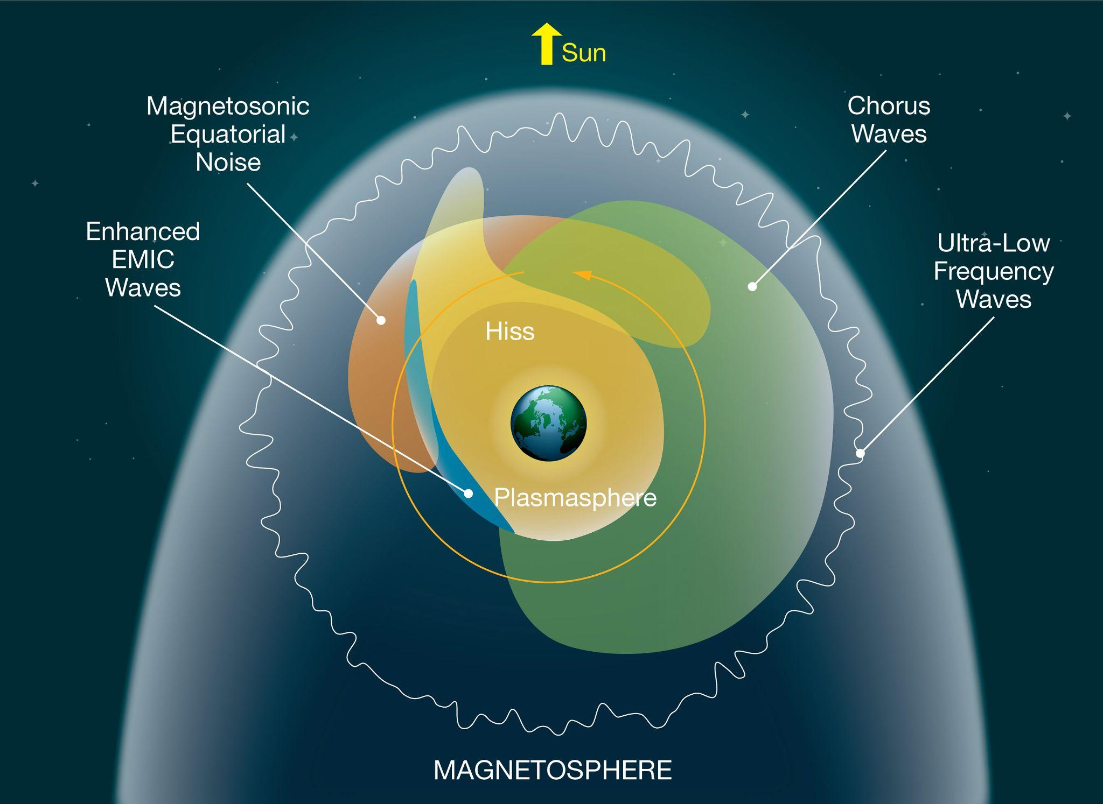
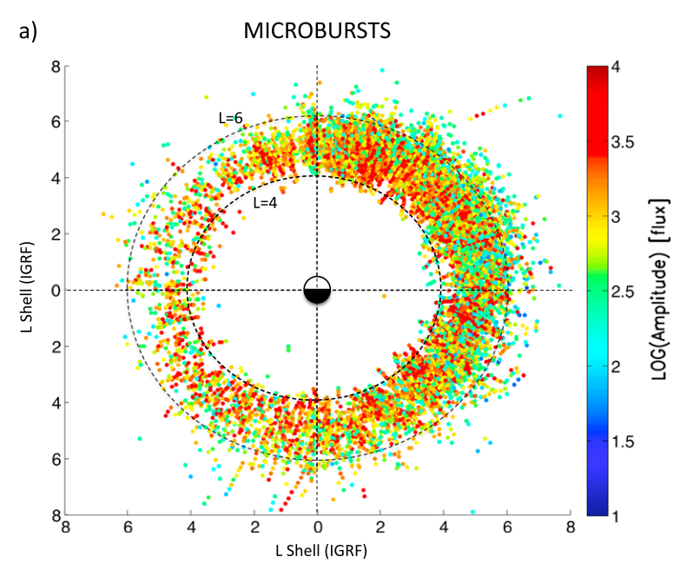
Introduction: Whistler Waves and Relativistic Electron Precipitation
Whistler waves are coherent electromagnetic emissions in the range of 0.1-3 kHz.
It has been widely suggested to be involved in both acceleration, and loss of relativistic electrons from the Van Allen Belts, but the process is not well understood yet.
Both waves and relativistic precipitation are mainly observed in the dusk sector.
Relativistic precipitation can damage spacecraft electronics.
Baker (2021)
Blum et al. (2015)

Slide 4
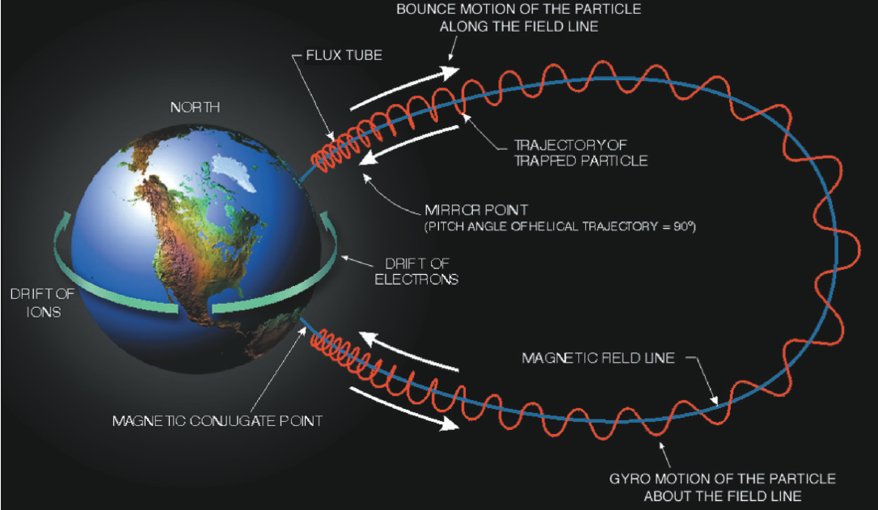
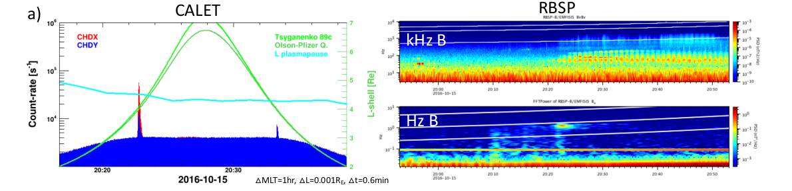
Introduction: Whistler Waves & Relativist Precipitation Events
The theory behind this hypothesis is that the whistler waves have a frequency similar to the gyrofrequency of relativistic electrons ( > 1 MeV). Suggesting that wave-particle interaction could change the particle pitch angle and result into particle precipitation that can observed at LEO.
Adapted by Wing (2016) from Lyons and Williams (1984)
Courtesy of A. Bruno

Slide 5
Motivation
There are several years of plasma wave observations from the Van Allen Probes (2012-2019) and Relativistic Electron Precipitation from CALET (2015-present).
The time scale of whistler waves and Relativistic Electron Precipitation (REP) events are in the scale of seconds for the whistler waves, and minutes for the REP events.
As result, in general we have more data that we can handle.
The objective of this part of this study is to implement an unsupervised methodology to detect and characterize different types of REP events.
Create a database of events for individual and statistical studies to understand better under which conditions REP events occur and their relationship with plasma waves in the Van Allen Radiation Belts.
Personal motivation: Introduce myself into machine learning techniques.

Slide 6
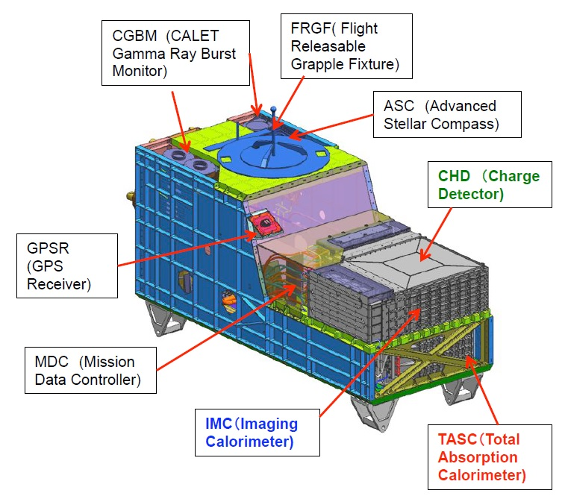
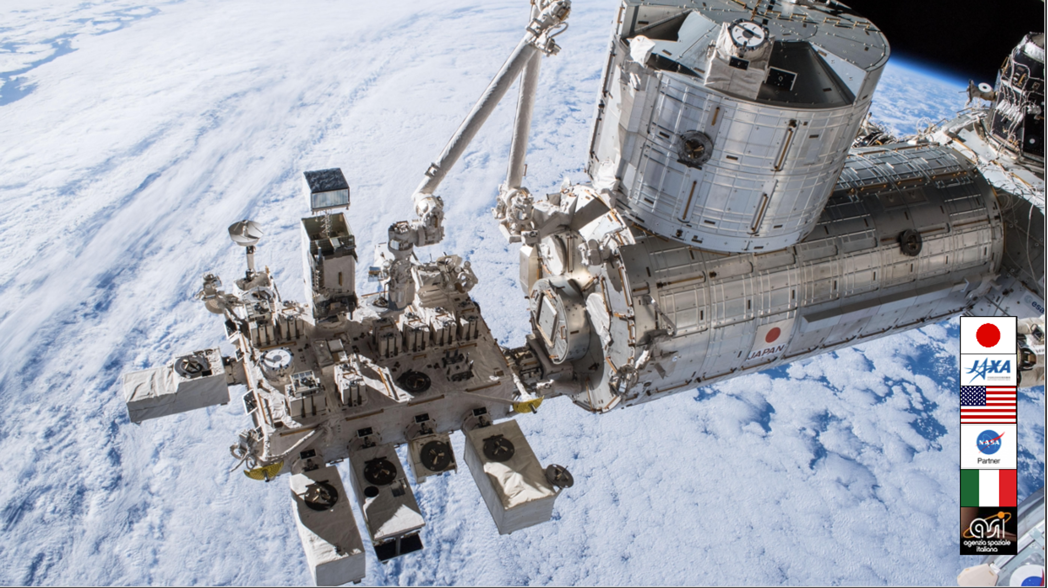
CALET Instrument (2015 - Present)
CALET is an astrophysics mission of JAXA (Torii 2016, Asaoka et al. 2019), and is attached to the Japanese Module “Kibō” in the International Space Station (ISS; ~400 km).
The CHDY and CHDX CALET channels can measure electron energies above 1.5 MeV and 3.4 MeV, respectively. These observations have been already used to study relativistic electron precipitation and their relation with plasma waves (Kataoka et al. 2016, 2020; Bruno et al. 2019, 2021).
Brogi et al (2020)

Slide 7
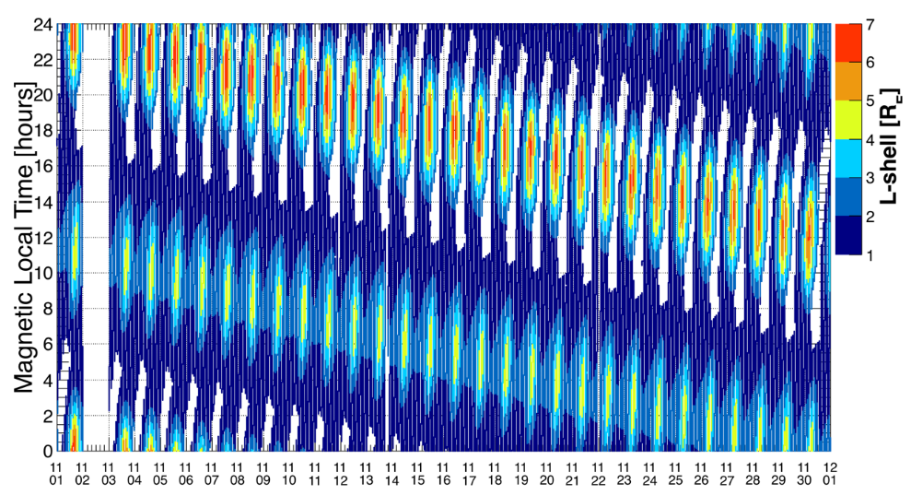
CALET: ISS Orbit
Courtesy of A. Bruno
MLT and L shell coverage of the CALET instrument on board the ISS during an example month, showing that the outer radiation belt is sampled at select MLTs, which vary over time.

Slide 8
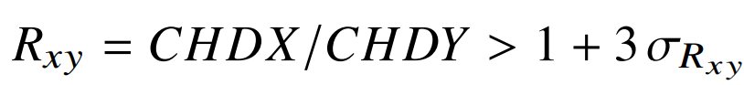
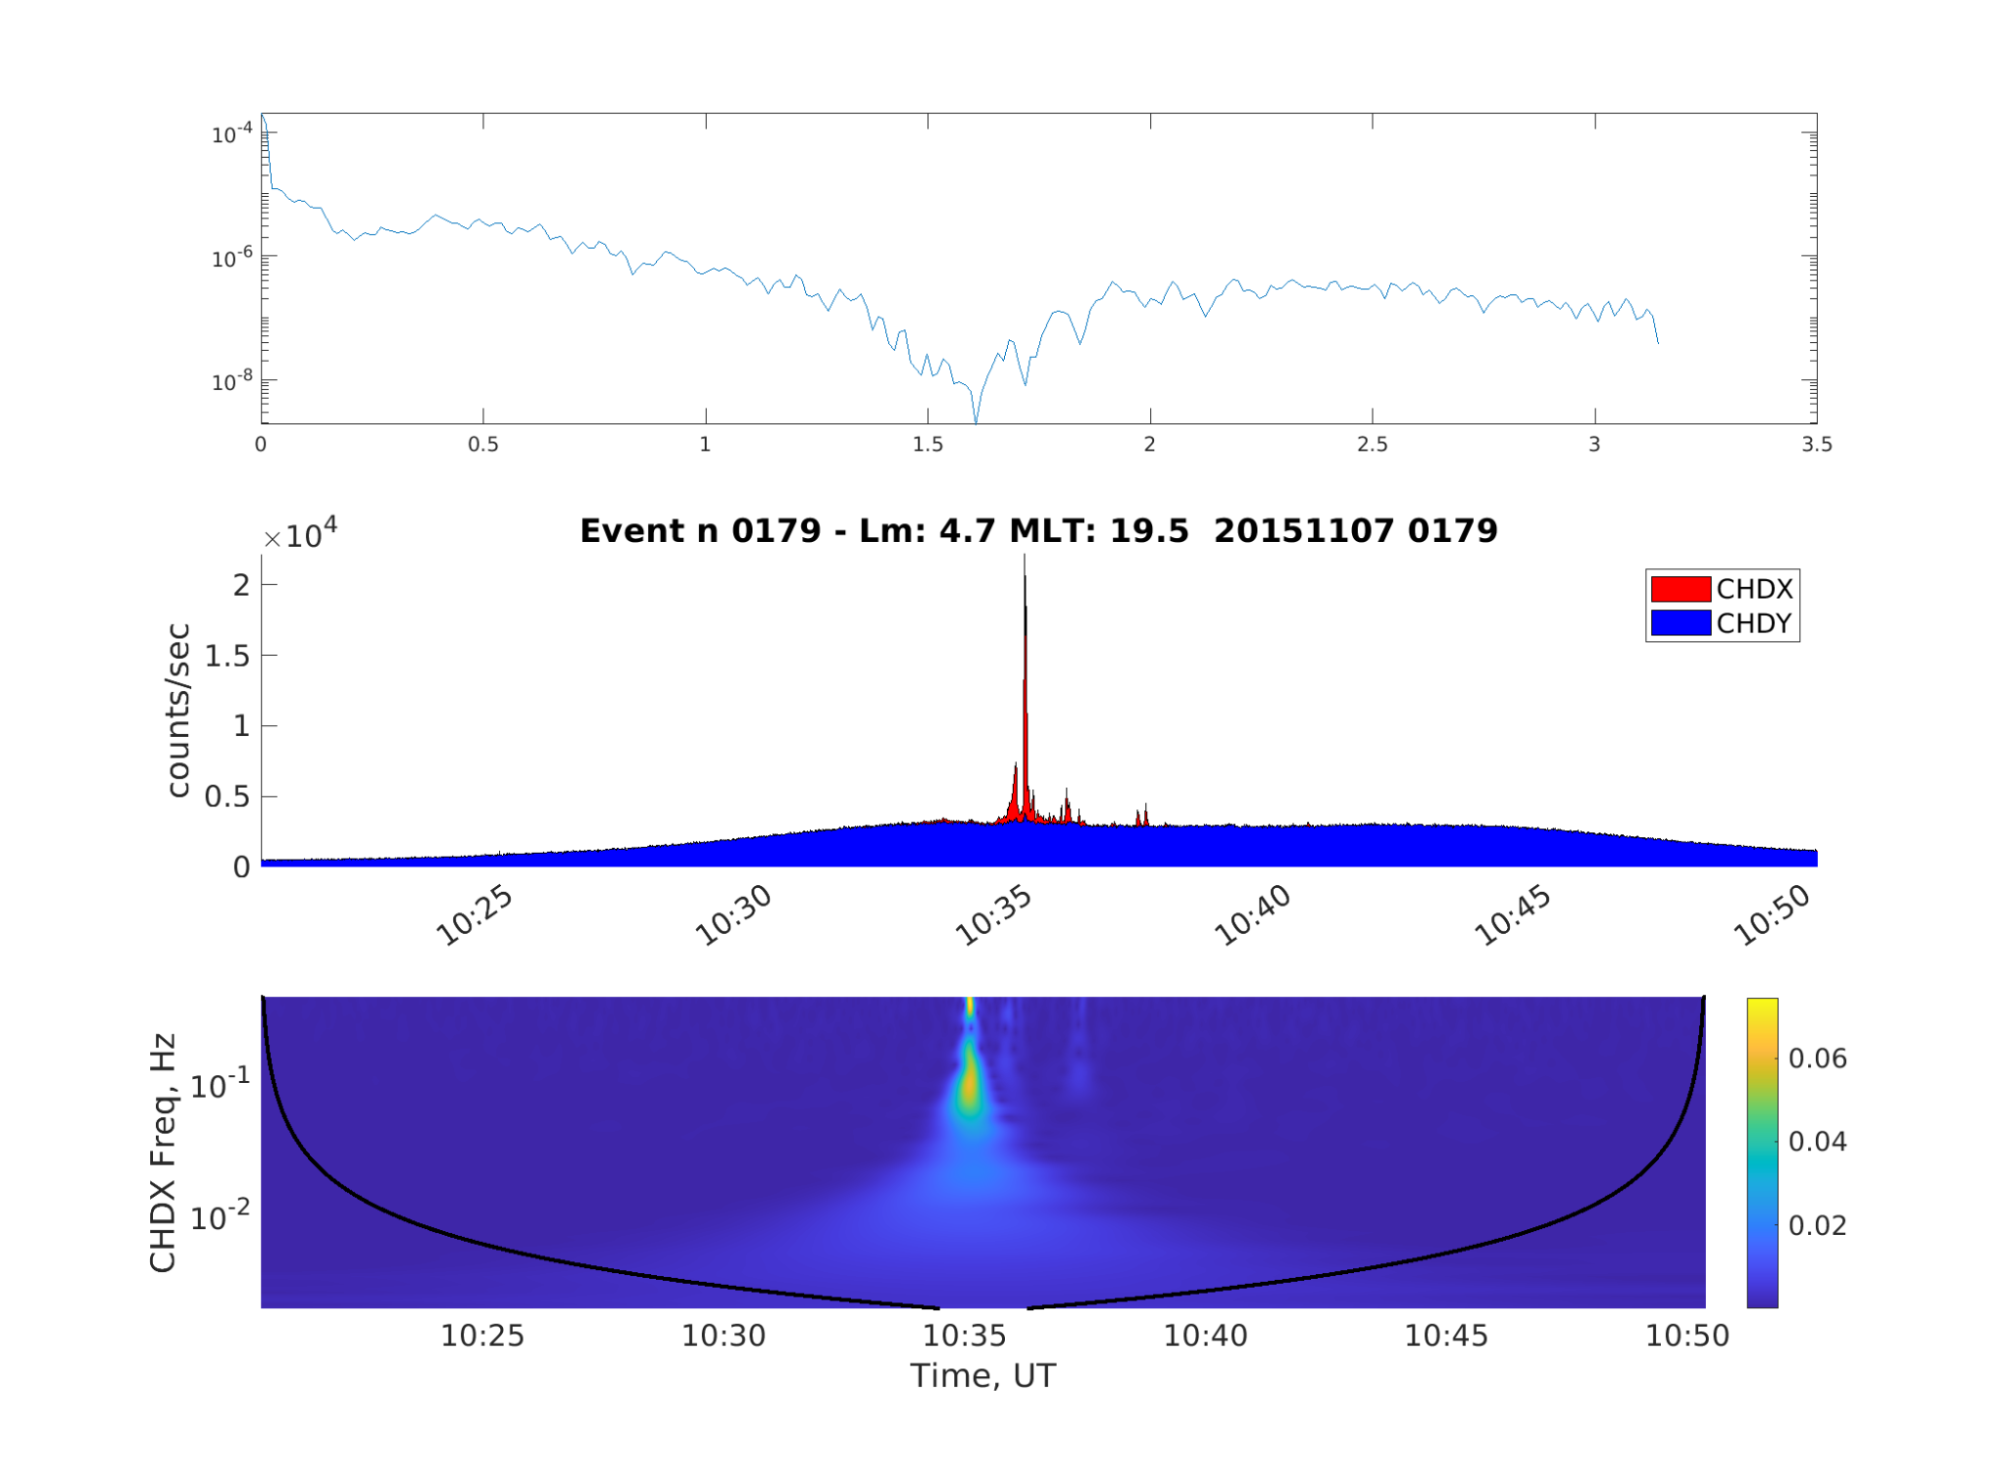
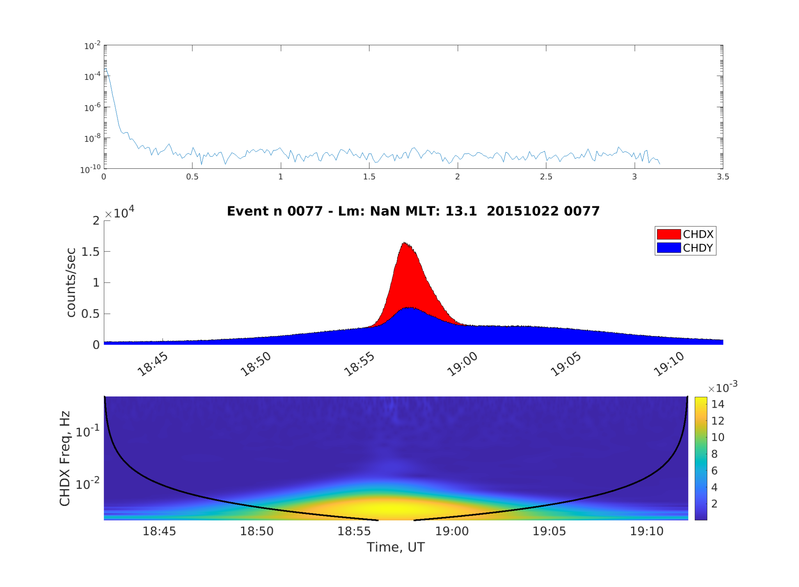
CALET: Observations
Using the index ratio between the two channels (Bruno et al. 2022) more than 12000 events are initially detected.
Relativistic Electron Precipitation Event:
Bursty precipitation likely as result of pitch angle change from wave-particle interaction.
These types of events represent less than 10% of events detected using the ratio index.
Background Precipitation Event:
Most likely due to Van Allen Belt crossing.
These types of events represent more than 90% of the events detected using the ratio index.

Slide 9
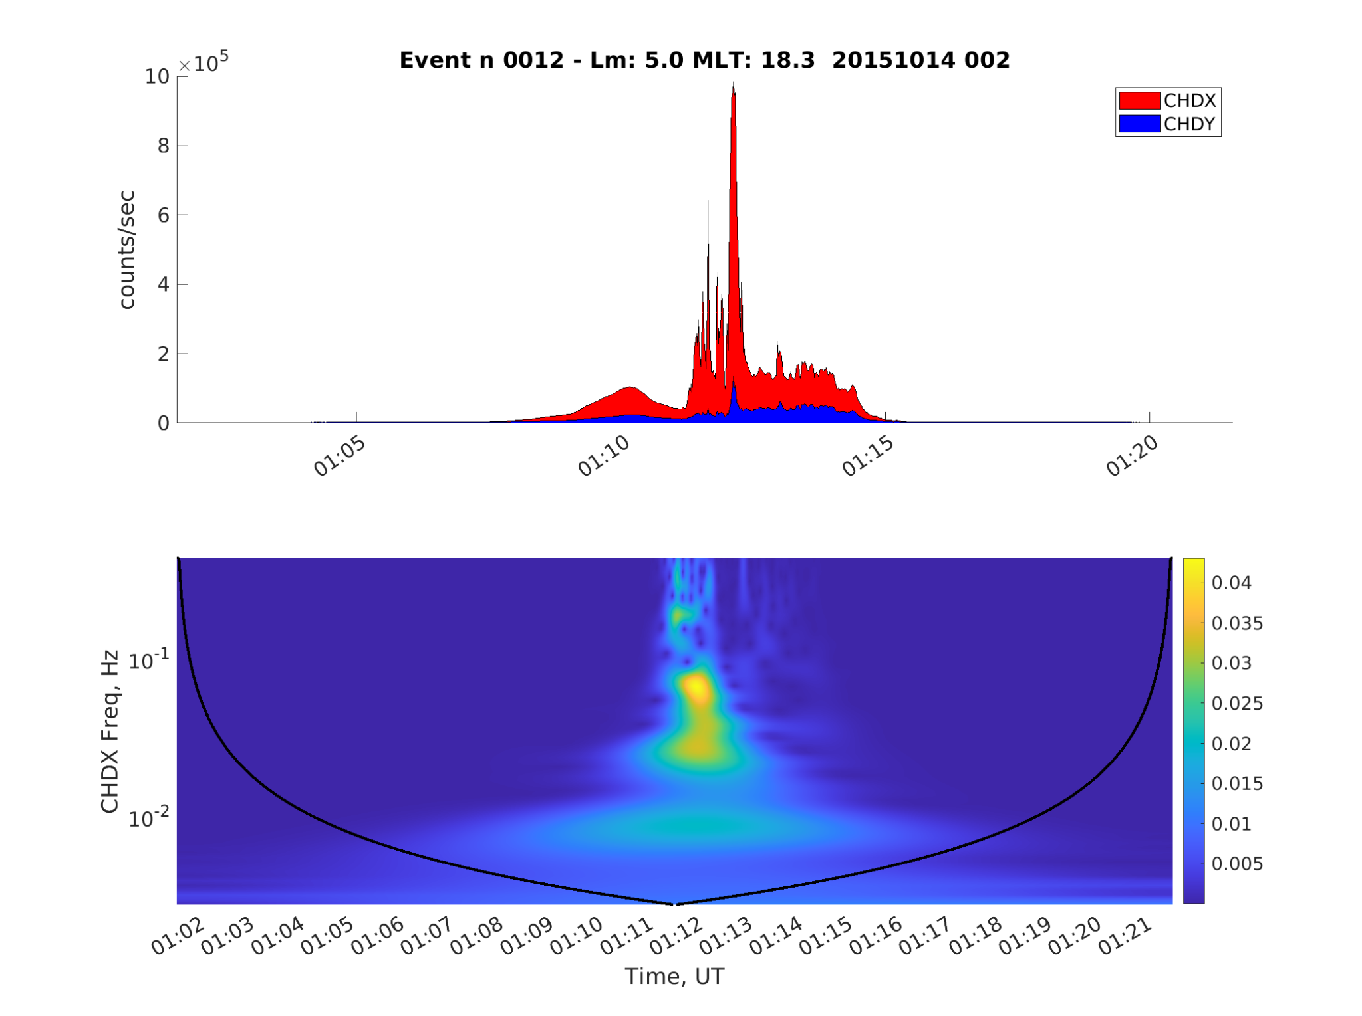
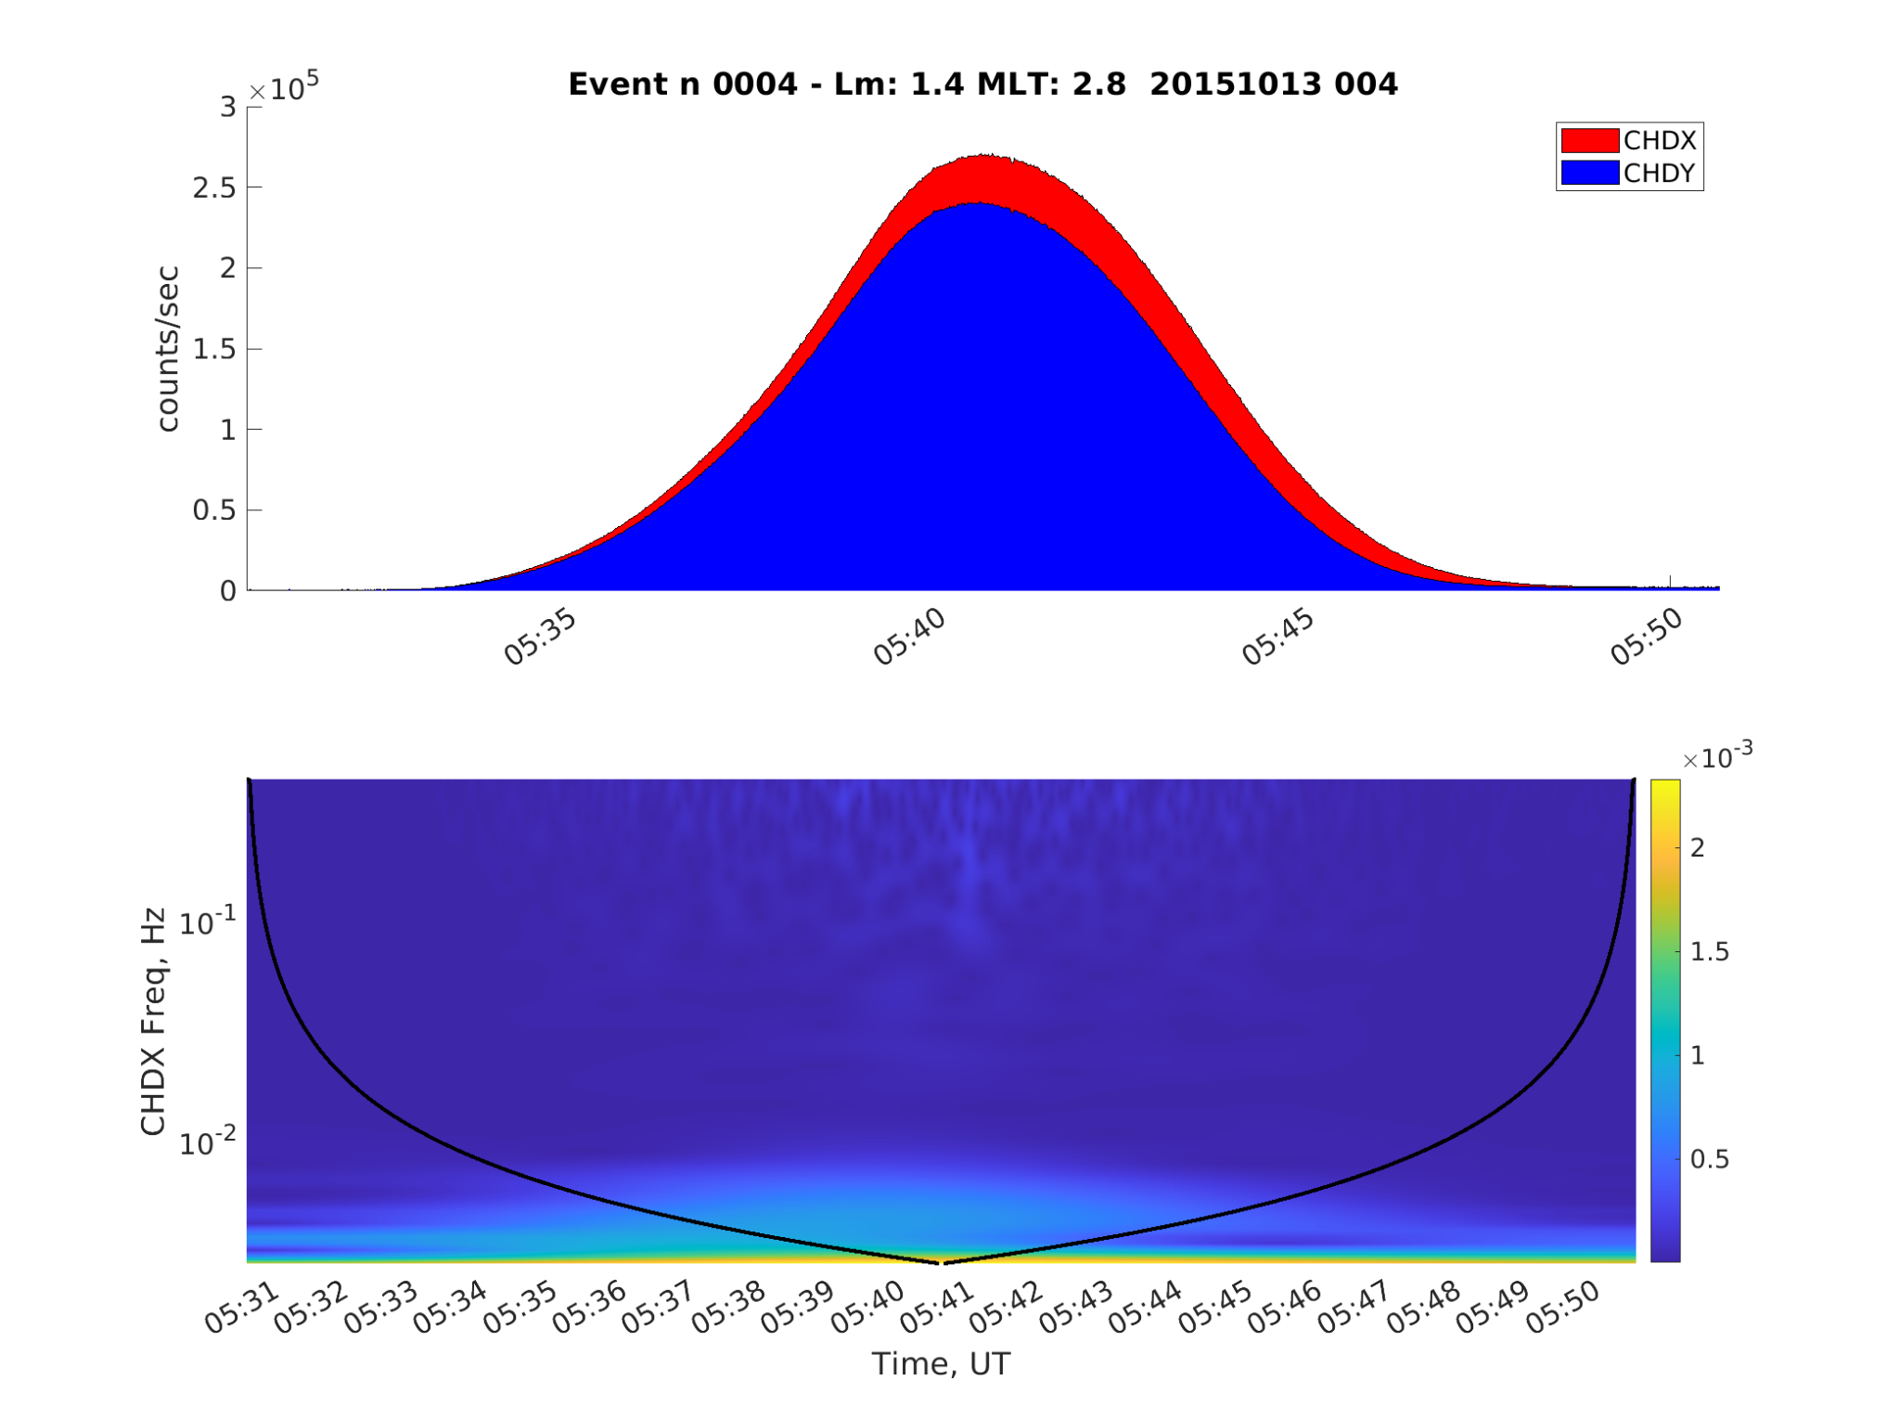
Electron Precipitation Observed in the Frequency Domain
On a first approach we separated between frequencies. While this was an improvement in comparison with the ratio index, we estimated that the number of false negatives was around 3%, which was equivalent to ~360 events.
REP Event
Background Event

Slide 10
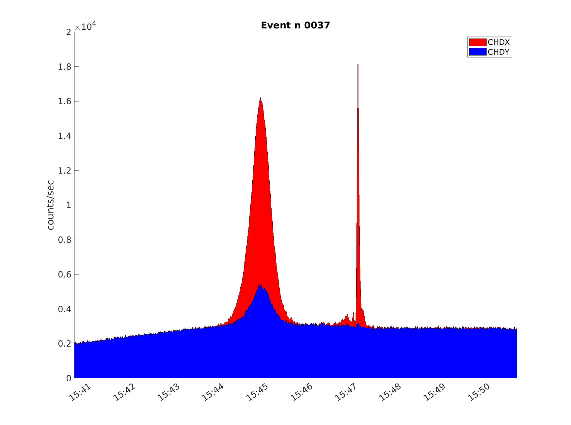
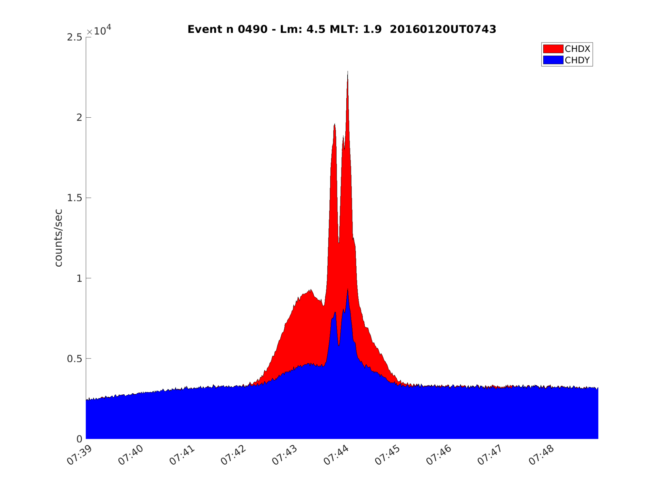
CALET: Detection Challenges of Precipitation Events
Simultaneous REP and background events occurrence difficult the use of algorithms based on indices. Visual inspection is the most common option, but it limits the amount of events that can be analyzed.
REP Event
Background Event
REP Event
Background Event

Slide 11
Self-Organizing-Maps
It uses an artificial neural network to reduce the number of dimensions of a set of data, by clustering data that have similar characteristics (Kohonen 1990, 2013).
It uses competitive learning to improve performance of every node.
It requires the previous identification of a feature in the data that could be classified.

Slide 12
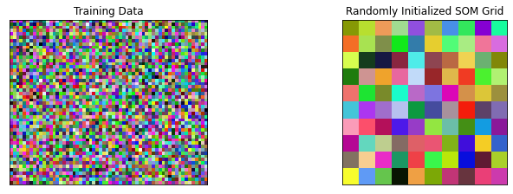
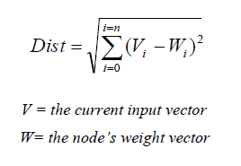
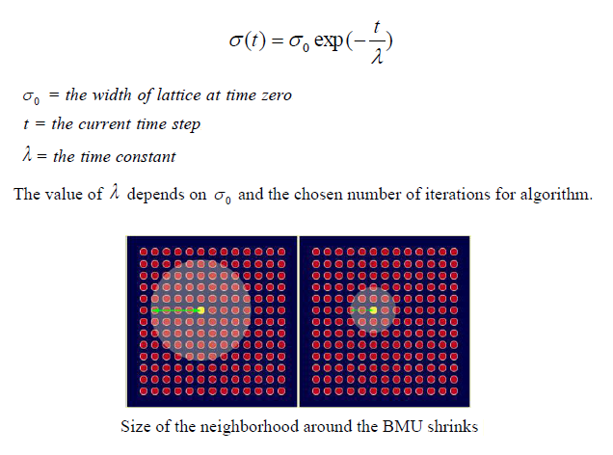
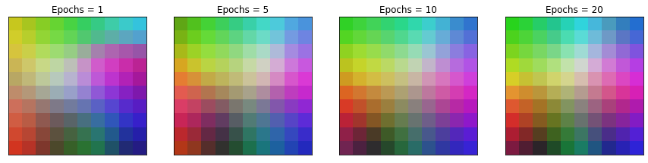
Self-Organizing-Maps: Example

Slide 13
Methodology
Initial event detection
Moving mean
Obtain power spectral density
Welch’s method
Train data = 70%
Initial random/Updated SOM matrix
Introduce changes to SOM
Find Best-Matching-Unit
Update Weights for Best-Matching-Unit and nearby cells
Test data = 30%
Test
Apply the SOM

Slide 14
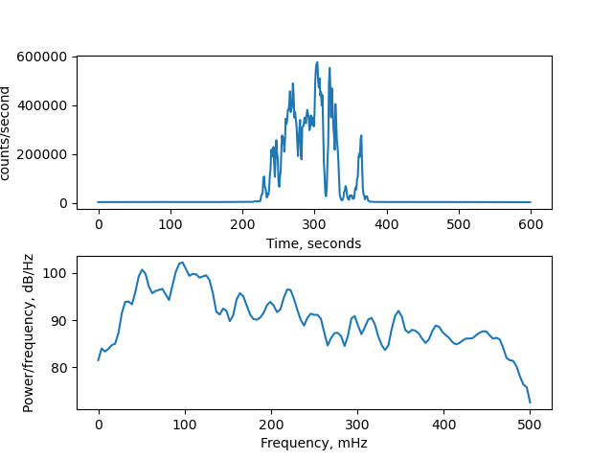
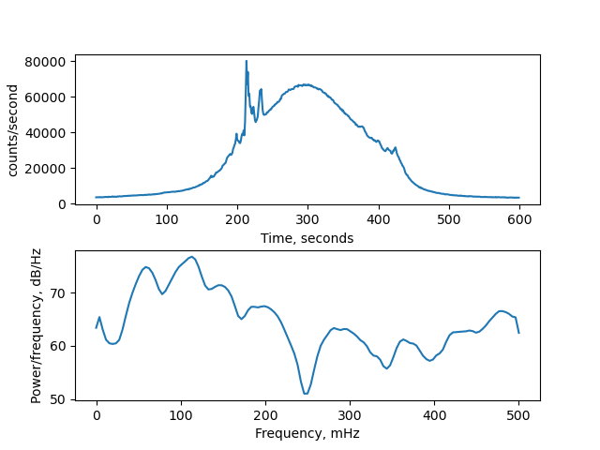
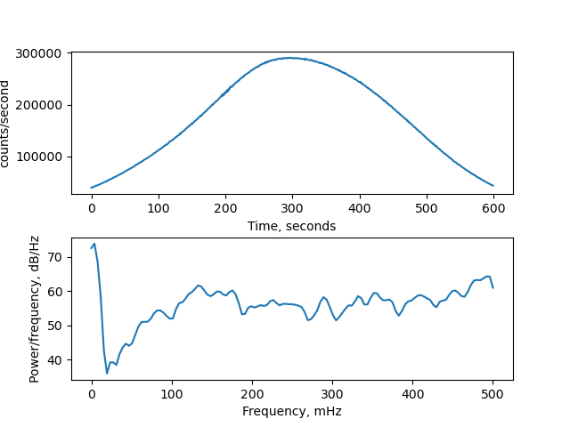
Results
Events that show similar spectral density profiles are clustered together.
Selected Events
Discarded Events
Standard REP event
Mixed Background/REP event
Background event
CHDX
CHDX
CHDX

Slide 15
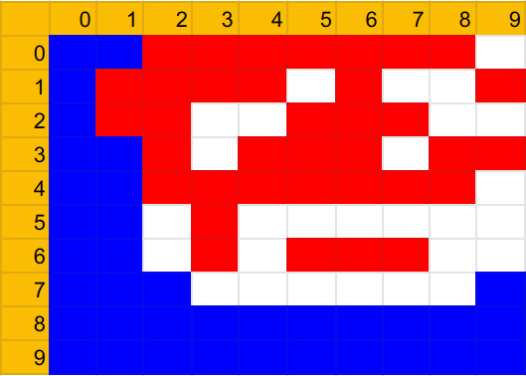
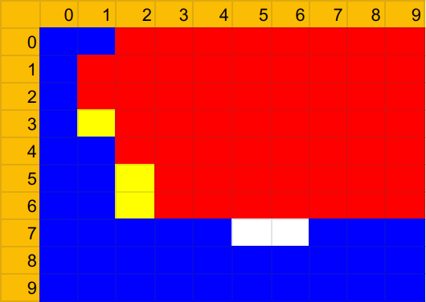
Results: Map
Test using 30% of the data
Red cells : Clusters with 100% of REP events.
Blue cells : Cluster with 100% background events.
Yellow cells : Clusters where is hard to know if REP or background event, or with 1 or more misplaced event.
Black cells : Cluster without events.
SOM applied to all the data

Slide 16
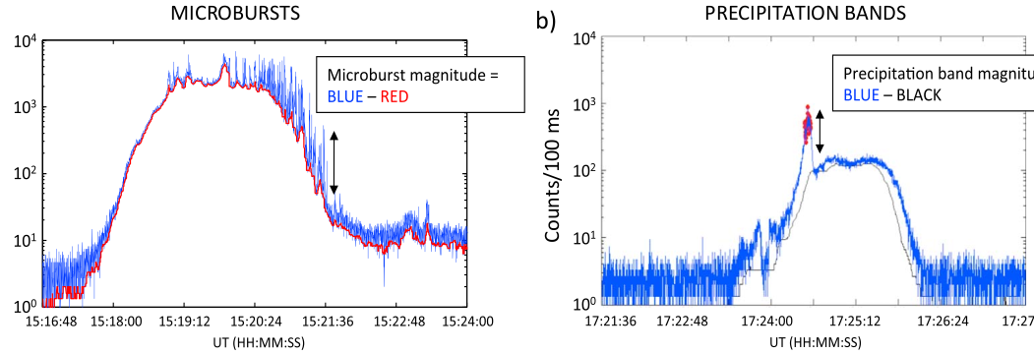
Conclusions
We use Self-Organizing-Maps for classification of different types of relativistic electron precipitation observed by CALET at LEO orbit.
It allows the future automation of the detection process.
Allows the generation of larger data sets for statistical studies.
Self-Organizing-Maps have a convenient usefulness/difficulty ratio for data analysis.
Similar technique can be used for other types of precipitation data set (i.e. SAMPEX), to detect and differentiate microbursts and Band Precipitation.

Slide 17
Future Work
Implement this methodology for automatic detection/classification of CALET observations.
Use the same technique for the characterization of REP events only, by removing the background events the quality of their categorization should improve.
Use a similar methodology for the identification of waves observed Van Allen Probes, MMS, and THEMIS (i.e. Vech & Malaspina 2021).
Find spacecraft conjunction events using L-shell and associate different types of REP events to different types of waves observed in the outer radiation Van Allen Belt.

Slide 18
Thanks!

